Slide 1
Why China should invest in Bangladesh, The next Asian Tiger
Strategic Growth, ROI, and Geopolitical Synergy

Slide 2
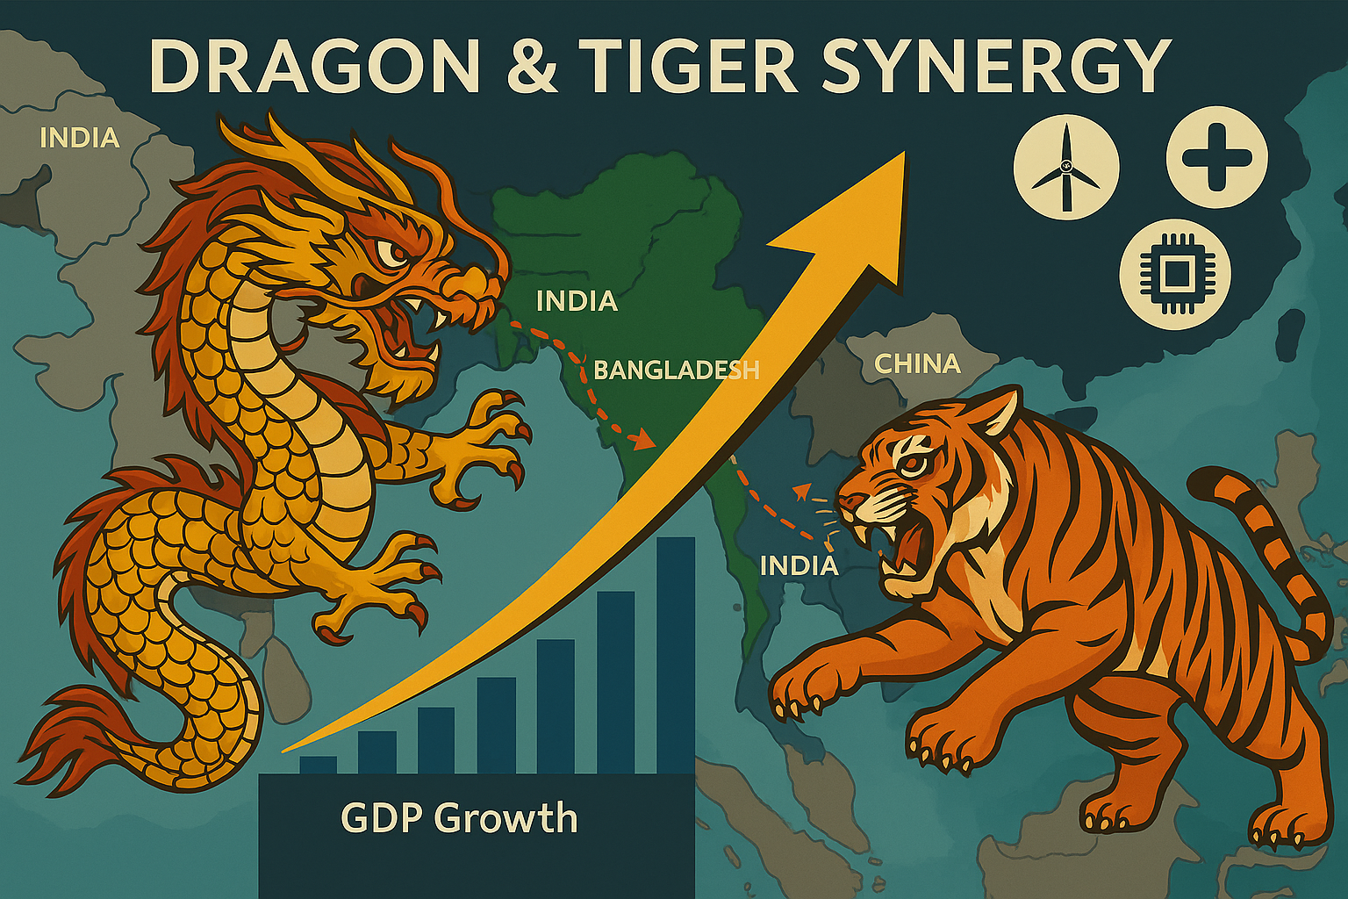

A Data-Driven, Multi-Dimensional Investment Blueprint

Slide 3
Projected Expansion
$300 BN USD
$80 BN USD
2024
2040

Slide 4

Bangladesh’s $500 BN Export Market
$300-$500 BN Economy
By 2040
Future projection by 2040
70% → Textile export growth to $100B.
34% → Renewable energy capacity (20% of grid).
ICEBERG

Slide 5
Executive Summary
Bangladesh is China’s Best Bet
GDP in 2023
Largest FDI source is China
Export in FY 2023-2024
$437.42 Billion
$12 Billion
$42.35 Billion
5.78% ^
15.45% ^
3.9% ^

Slide 6

Chaina - $5B
Bangladesh Export Destination
71%
EU - $38B
2023
India - $2B
Market is in EU
USA - $8B

Slide 7






Our Customers around the world
No.
2003 Exports (Billion USD)
2022 Exports (Billion USD)
Key Products
Countries
1.
Apparel (knitwear, woven garments)
$2.50
$10.10
USA
2.
RMG, textiles, footwear
$1.20
$7.00
Germany
3.
RMG, leather goods, frozen shrimp
$0.70
$4.80
UK
4.
Woven garments, home textiles
$0.30
$3.00
Spain
5.
RMG, jute products, ceramic tableware
$0.20
$2.30
France

Slide 8
Chaina dominates
Japan - $4B
USA – $3B
60%
China - $12B
2023
Tier D
of total FDI

Slide 9




Porter’s Five Forces – Industry Competition
1. Low (abundant labor, raw materials)
2. Moderate (other LDCs like Cambodia, Myanmar)
3. Moderate (Vietnam, India compete but Bangladesh has lower wages)
4. High (textile dominance, but untapped sectors like tech & energy)
5. High (EU, US, China demand cheap goods)
Bargaining Power of Suppliers
Bargaining Power of Buyers
Abundant labor and raw materials
Threat of new Entrants
Buyers always want best price and we can provide that
Industry Rivalry
Vietnam, India can not compete us with cost
Threat of Substitutes
Textile dominance, untapped sectors like tech and energy
We are already in advantage

Slide 10
✔ Cheap labor (lowest wages in Asia)
✔ Young workforce (65% under 35)
✔ Duty-free access to EU, China
✔ Rapid urbanization (40M+ middle class by 2030)
Why Bangladesh?
❌ Bureaucracy & corruption
❌ Infrastructure gaps
❌ Energy shortages
❌ Political instability risks
Strengths
Weakness
✅ China’s Belt & Road Initiative (BRI) projects
✅ Textile, Pharma, IT, & Renewable Energy boom
✅ Special Economic Zones (SEZs) for Chinese firms
SWOT Analysis
⚠ Geopolitical tensions
⚠ Rising competition (Vietnam, India)
⚠ Climate change risks (floods, cyclones)
Opportunities
Threats

Slide 11

PESTLE Analysis – Macroeconomic Factors
Political
Technology
Pro China Govt, BRI partnership
Increasing technological exports
Economics
Legal
465 B GDP
GDP growth 7%
SEZ’s under special regulation
Social
Environmental
170 M Population, 65% youth
Renewable energy demand

Slide 12
Bangladesh vs. Competitors
Labor Cost Advantage
$120
$180-$250
Balance
Bangladesh
Vietnam/India

Slide 13

Top 5 Sectors For Chinese Investment
Textiles
Pharma
Renewables
Infrastructure
Digital Economy
^{12-15%}
^{25%}
^{15-20%}
^{20-30%}
^{30%}
BRI projects ($30B+)
WHO-certified, exports to 150+ countries
#2 global exporter ($42B)
40,000 MW demand by 2030
60M internet users, $5B
e-commerce market
Market Growth Presentation
Page 13

Slide 14
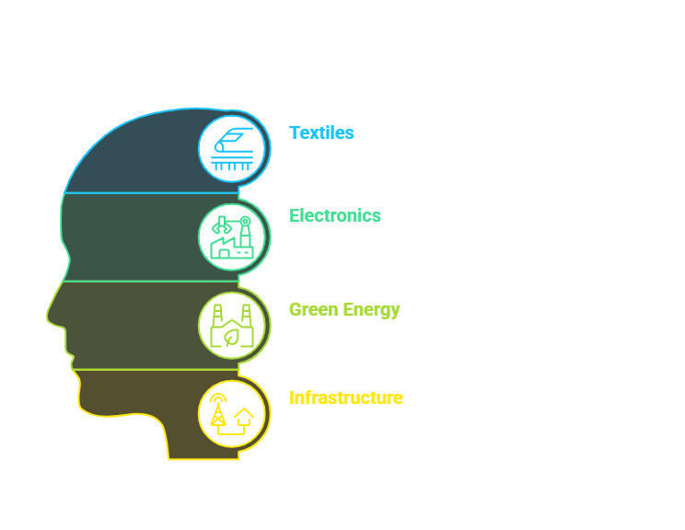
Win-Win Markets for China & Bangladesh

Slide 15
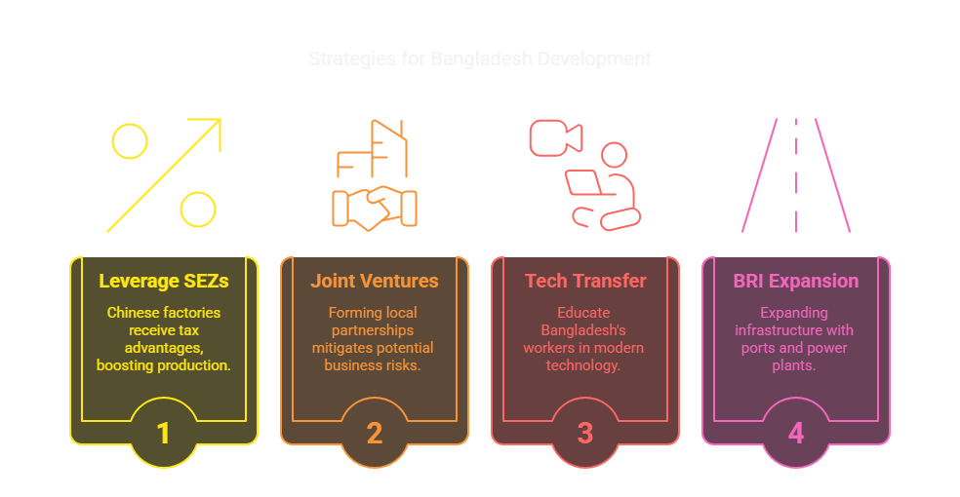
Strategic Recommendations for China

Slide 16
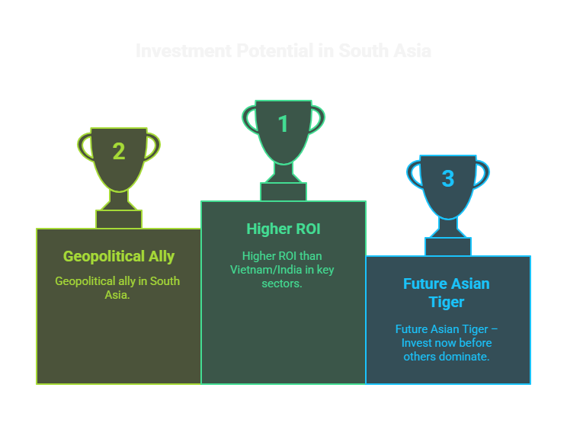
Bangladesh is China’s Best Bet
"China does not just invest in Bangladesh—it invests in the next global manufacturing and digital hub."

Slide 17
References:
◆ World Bank. (2023). Bangladesh Development Update. Washington, DC. https://www.worldbank.org/en/country/bangladesh
◆ Bangladesh Bank. (2023). Foreign Direct Investment Report. Dhaka. https://www.bb.org.bd/en/
◆ UNCTAD. (2023). World Investment Report. Geneva. https://unctad.org/wir
◆ MOFCOM. (2023). Belt & Road Project Database. Beijing. http://english.mofcom.gov.cn/
◆ IMF. (2023). South Asia Economic Outlook. Washington, DC. https://www.imf.org/en/Countries/BGD
◆ EPB Bangladesh. (2023). Export Performance Report. Dhaka. https://www.epb.gov.bd/
◆ BBS. (2023). Labour Force Survey. Dhaka. http://bbs.portal.gov.bd/

